Slide 1


December 4
Cash Vs Card
Contributor
Keidrick Wooten
Contributor
Austin Swaim

Slide 2
Purpose
Customer Preferences and Behavior
Operational Efficiency
Cost Analysis
Revenue Tracking and Financial Reporting
Customer Experience
Strategic Decision Making

Slide 3
Constraints/
Setbacks
Card reader was out for three months in August at Popeyes
Cash payments were dramatically increased so we had to wait a full month to get a full analysis of data starting with the month of September.

Slide 4
Metrics Analyzation
Credit Card: Transactions processed with Credit/Debit Cards in store
Doordash: Transactions processed with Credit/Debit Cards through online/mobile orders
Cash: Transactions processed with Cash payments in store.

Slide 5
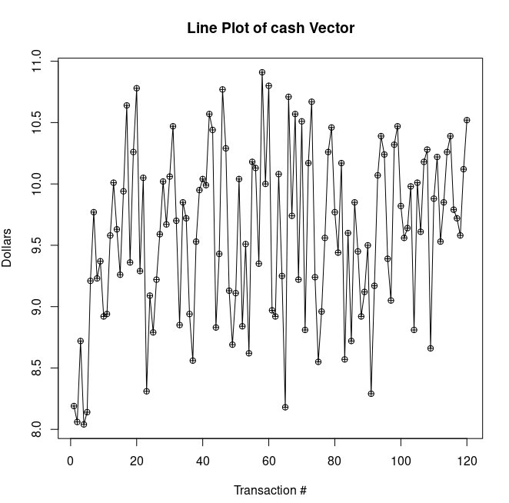
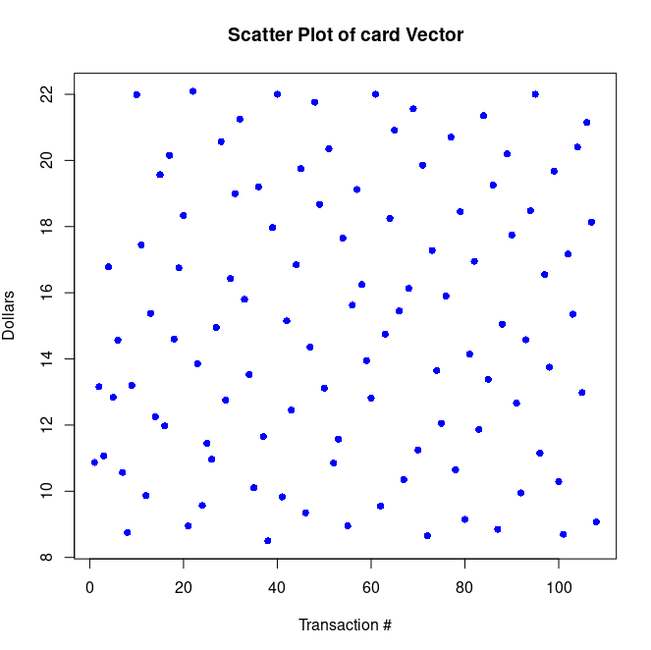
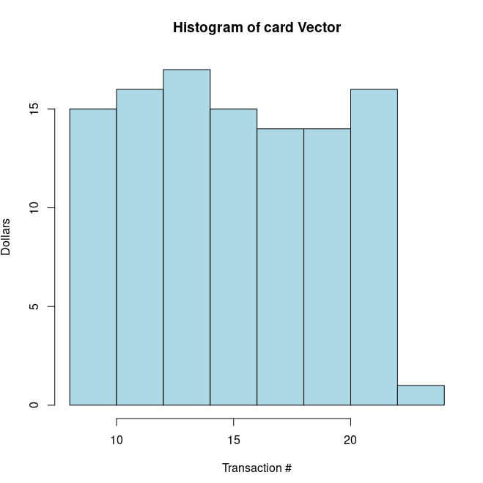
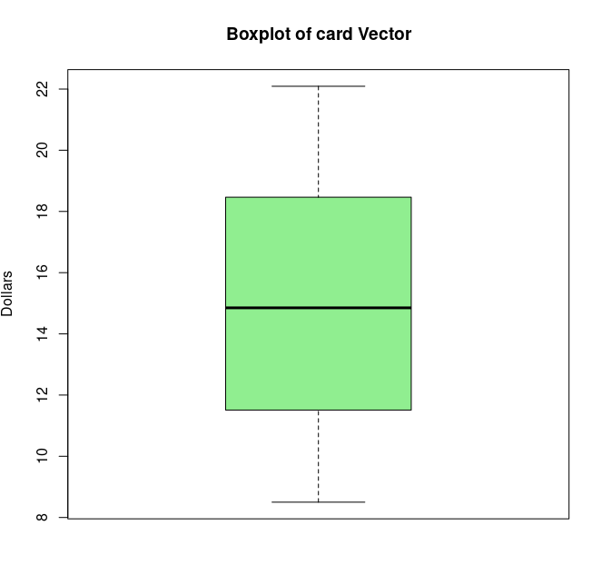
How we analyzed the data
Made a vector of both cash and card transactions, averaged them out, and was able to compare the two just based off of raw data.
Then we took this data after we cleaned it up, and made graphs for the data visualization class.

Slide 6
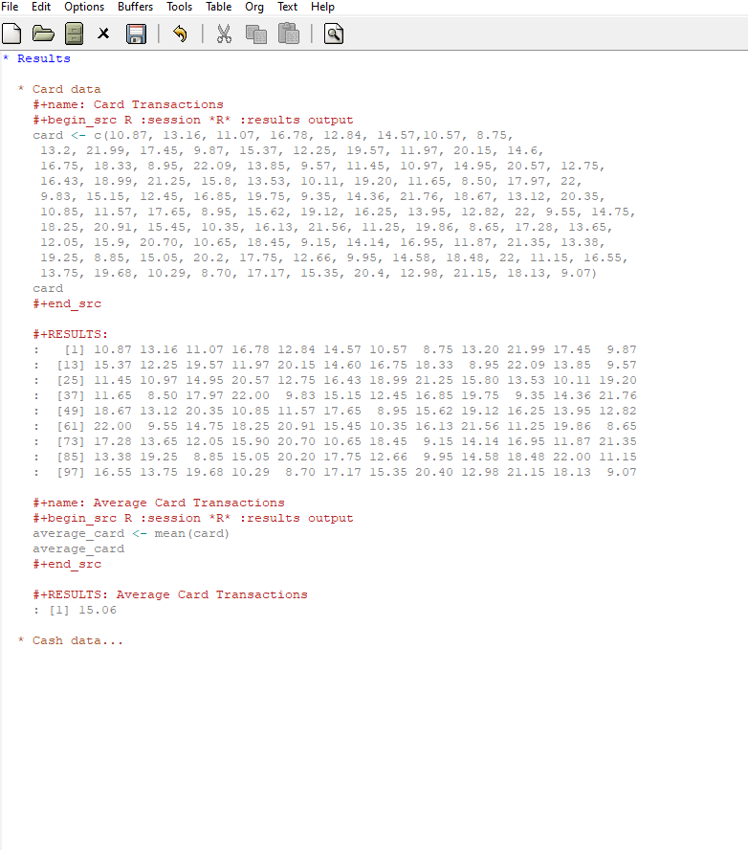

Slide 7
Goals & Achievements
Develop a System that tracks how many customers use Credit/Debit cards Vs. Cash in transactions
Tracking the average of Card and Cash transactions respectively
Got into contact with the aloha NCR pos and got them to add specific categories into the paperwork

Slide 8
References
Popeyes Louisiana Kitchen. (n.d.). About us. Retrieved
September 15, 2024, from https://www.popeyes.com/about-us
R Core Team. (2023). R: A language and environment for
statistical computing [Software]. R Foundation for Statistical
Computing. https://www.R-project.org/
Kannan RR, Vasantha S. COVID 19 Outbreaks on the Growth of
Self Servicing Technology Using Digital Payments. Webology.
2021;18(2):22-40. doi:10.14704/WEB/V18I2/WEB18305

